Slide 1
Chapter 7
Views and Cursors

Slide 2
Review
Review of Index and Full-text Index
Indexing helps in retrieving the data quickly.
The CREATE INDEX statement is used for index creation on a given table.
FILLFACTOR specifies a value from 0 through 100 that indicates the percentage of the index page to be left empty.
There are two types of indexes, clustered and non-clustered.
A clustered index determines the storage order of data in a table. A table can have only one clustered index because the clustered index dictates the physical storage order of the data.

Slide 3
Review Contd…
A non-clustered index specifies a logical ordering of a table. Therefore, a table can have multiple (up to 249) non-clustered indexes.
Clustered and non-clustered indexes can be created as unique or composite.
Unique indexes do not permit duplicate values in the index column.
Composite indexes permit two or more columns to be used in the creation of the index.
The sp_helpindex system stored procedure reports information about the indexes on a table.

Slide 4
Review Contd…
Optimizer hints force the query optimizer to choose a particular index for a query.
The DROP INDEX statement deletes an index.
A full-text index tracks the significant words in a table. This index is used for searches that contain indexed words and for advanced search options, such as phrase searches.
A full-text catalog is a directory where all the full-text indexes for a database are placed.

Slide 5
Review Contd…
The CONTAINS keyword searches columns containing character-based data types for matches to single words and phrases, for words within a certain distance of one another, or weighted matches.
The FREETEXT keyword searches columns for values that match the meaning and not the exact wording of the words in the search condition.

Slide 6
Objectives
Define a view
List the advantages of Views
List the guidelines for creating Views
Describe data modification through views
Explain view deletion
Define a cursor
Describe cursor creation
Understand the cursor execution process
Explain fetching of cursor rows

Slide 7
Views
A view is an alternate way of looking at data from one or more tables in the database.
A view is a virtual table, usually created as a subset of columns or rows from one or more tables.
A view does not exist as a set of stored data values in a database.
A view acts as a filter on the table addressed in the query.

Slide 8
Uses of views
Filter rows from the table
Protect sensitive data from unwanted users
Decrease database complexity
Abstract various physical databases into a single logical database

Slide 9
Advantages of views
Advantages of Views for the End User
  Easier to understand results
  Easier to obtain data
Advantages of Views for the developer
  Easier to restrict data retrieval
  Easier to maintain applications

Slide 10
Creating Views
The CREATE VIEW statement is used to create a view using T-SQL. The syntax is:
CREATE VIEW <Viewname> AS <Select Statement>
Example:
CREATE VIEW NewMoon_employee AS
SELECT emp_id, fname, minit, lname,hire_date
FROM employee e, publishers p
WHERE e.pub_id = p.pub_id
AND pub_name = 'New Moon Books'

Slide 11
Guidelines for creating
Views
Views can be created only in the current database.
A view name should be similar to the table name because it is easy to remember and associate. It should follow the naming conventions for identifiers.
A view can be built on other views. SQL Server allows views to be nested up to 32 levels. It can contain upto 1024 columns from one or more tables or views.
Defaults, rules and triggers cannot be associated with views.
Views cannot be indexed.

Slide 12
Guidelines for creating
Views Contd…
Temporary tables cannot participate in views.
View definition remains even if the tables are dropped.
The query defining the view cannot include ORDER BY, COMPUTE or COMPUTE BY clauses or the INTO keyword.

Slide 13
Modifying data through
Views
A view can modify the data in the base table provided:
The view contains at least one table in the FROM clause of the view definition.
No aggregate functions or GROUP BY, UNION, DISTINCT, or TOP clauses are used in the select list.
The view has no derived columns in the select list.

Slide 14
Deleting Views
After the purpose of a view is served, it can be deleted to free resources.
Deleting a view does not affect the base tables.
The syntax of the statement to delete a view is:
DROP VIEW view_name
Example:
DROP VIEW NewMoon_employee

Slide 15
Cursors
A cursor is a database object used by applications to manipulate the data by rows instead of sets.
Using cursors, it is possible to:
  Allow positioning at specific rows of the result set.
  Retrieve a single row or set of rows from the current position in the result set.
  Support data modifications to the rows at the current position in the result set.
  Support different levels of visibility to changes made by other users to the database data that is presented in the result set.

Slide 16
Cursors Contd…
  Provide Transact-SQL statements in scripts, stored procedures, and triggers to access the data in a result set.

Slide 17
Creating a Cursor
The DECLARE statement is used to create a cursor.
It contains the SELECT statement to include the records from the table.
The syntax is:
DECLARE <Cursor_Name> CURSOR
[LOCAL | GLOBAL]
[FORWARD ONLY | SCROLL]
[STATIC | KEYSET | DYNAMIC |FAST_FORWARD]
[READ_ONLY | SCROLL_LOCKS | OPTIMISTIC]
[TYPE_WARNING]
FOR <Select Statements>
[FOR UPDATE [OF Column_name[,….N]]]

Slide 18
Steps in Using a Cursor
Open the Cursor
OPEN <Cursor_name>
Retrieve the records
FETCH <Cursor_name>
Close the Cursor
CLOSE <Cursor_name>
Remove Cursor reference
DEALLOCATE <Cursor_name>

Slide 19
Fetching and scrolling
a Cursor
FETCH FIRST: Fetches the first row in the cursor.
FETCH NEXT: Fetches the row after the previously fetched row.
FETCH PRIOR: Fetches the row before the previously fetched row.
FETCH LAST: Fetches the last row in the cursor.
FETCH ABSOLUTE n: If n is a positive integer, it fetches the nth row in a cursor. If n is a negative integer, the nth row before the last row in a cursor is fetched. If n is 0, no rows are fetched.

Slide 20
Fetching and scrolling
a Cursor Contd…
FETCH RELATIVE n: Fetches the n^{th} row from the previously fetched row, if n is positive. If n is negative, the nth row before previously fetched row is fetched. If n is 0, the same row is fetched again.

Slide 21
FETCH statement global
variables
@@FETCH _STATUS: Returns an integer for the last cursor FETCH statement executed.
@@CURSOR_ROWS: Returns the number of qualifying rows that are in the currently open cursor.

Slide 22
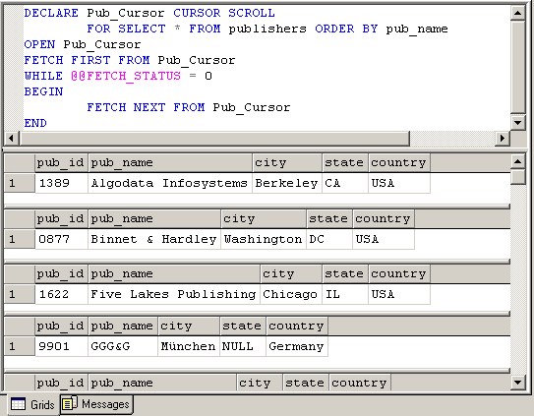
Cursor creation example

Slide 23
Summary
A view is an alternate way of looking at data from one or more tables in the database. A view is a virtual table usually created as a result of query execution.
A view acts as a filter on the table addressed in the query.
The CREATE VIEW statement is used to create a view.
The DROP VIEW statement is used to delete a view.
Cursor is a database object used by applications to manipulate data by rows rather than sets. Using cursors, multiple operations can be performed row by row against a result set with or without returning to the original table.

Slide 24
Summary Contd…
A cursor is created using DECLARE statement. First a cursor is declared or created in the memory. Then it is opened.
OPEN statement is used to open the cursor. Retrieving records from a cursor is called fetching. A user can retrieve only one record at a time.
FETCH command is used for reading the records from the cursor.
By default, a cursor is forward only. It can fetch the records from the first record to the last record. It cannot directly fetch the first or last row in the table.

Slide 25
Summary Contd…
When a cursor is temporarily not required, it can be closed using the CLOSE statement.
Once the cursor is used, its reference should be removed using the DEALLOCATE statement.

